Slide 1
Graph Traversal
READING: CHAPTERS 14
DATA STRUCTURES AND ALGORITHMS IN JAVA

Slide 2
Graph Traversal
Traversals of graphs are also called searches
Traverse a graph means to systematically visit every vertex exactly once.
Graph traversal more complicated than tree traversal
  graph may contain cycles
  traversal algorithm must be able to avoid dead-loops and repeated visits.
There are two basic methods for traversing a graph:
  Breadth-first requires a queue
  Depth-first requires a stack
Both traversal methods visit vertices according to their distance to the starting point. Their difference is:
  Depth-first attempts to move as far as possible.
  Breadth-first attempts to stay as close as possible,

Slide 3
Depth-First Graph Traversal
Consider implementing a depth-first traversal on a graph:
  Choose any vertex v
    Mark it as visited
    Perform an operation on that vertex
    Place it onto an empty stack
  While the stack is not empty:
    If the vertex on the top of the stack has an unvisited adjacent vertex, w,
      Mark w it as visited
      Perform an operation on that vertex
      Place it onto the top of the stack
    Otherwise, pop the top of the stack
  Done when the stack is empty

Slide 4
Depth-First Search
Use stack to remember where it should go when it reaches a dead end.
Try to get as far away from the starting point as quickly as possible
Pick a starting point, say vertex A
  Visit A and push it onto a stack so you can remember it
  Mark it so you will not visit it again
  Visit any vertex adjacent to A that has not been visited, say B
    Push it onto a stack and mark it visited so you will not visit it again
E
A
B
A
C
D
E
B
A
A
B
C
D

Slide 5
Depth-First Search
  Visit any vertex adjacent to B that has not been visited, say D
    push it onto a stack and mark it visited so you will not visit it again
  Visit any vertex adjacent to D that has not been visited, say C
    push it onto a stack and mark it visited so you will not visit it again
There is no unvisited vertices adjacent to C.
  if stack is not empty, pop a vertex from the stack
E
D
B
A
A
B
C
D
E
C
D
B
A
A
B
C
D

Slide 6
Depth-First Search
E
C
D
B
A
A
B
C
D
D
B
A
  Pop C, which brings you back to D.
    Visit adjacent unvisited vertex of D, mark it, and push it on the stack
    D has no unvisited adjacent vertices
  Pop D which brings you back to B
    Visit adjacent unvisited vertex of B, mark it, and push it on the stack
    B has E as unvisited adjacent vertex
    Visit E , push it onto a stack and mark it visited so you will not visit it again
B
A
E
E
B
A
A
B
C
D

Slide 7
Depth-First Search
E
E
B
A
A
B
C
D
There is no unvisited vertices adjacent to E
    if stack is not empty, pop a vertex from the stack
Pop E, which brings you back to B.
  B has no unvisited adjacent vertices
Pop B, which brings you back to A
  A has no unvisited adjacent vertices
Pop A, but now there is nothing left to pop,
  so we are done
B
A
A

Slide 8
Depth-First Search-Implementation
Modify class Graph as following:
class Graph {
…
private Stack theStack; // add a line to class Graph to declare a stack
public Graph() { // constructor
…
theStack = new StackX(); // create the stack
}
public int getAdjUnvisitedVertex(int v){ // returns an unvisited vertex adj to v
for(int j=0; j<nVerts; j++)
if(adjMat[v][j]==1 && vertexList[j].wasVisited==false)
return j;
return -1;
} // end getAdjUnvisitedVertex()
…
} // end class Graph

Slide 9
Depth-First Search-Implementation
Pseudo code
void dfs() { // depth-first search
//starting point is vertex with index number 0
mark vertexList[0] as visited;
displayVertex(0);
Push vertex with index 0 onto theStack
while( theStack is not empty ) {
currentVertex ← theStack.top();
int v ← getAdjUnvisitedVertex(currentVertex);
if no such vertex v exists
pop a vertex from the stack;
else { // if it exists,
mark vertexList[v] as visited;
displayVertex(v);
push vertex v onto the stack
}
} // end while => stack is empty, so we're done
for(int j=0; j<nVerts; j++) // reset flags
mark vertexList[j] as not visited;
} // end dfs

Slide 10
Breadth-First Search
Consider implementing a breadth-first traversal on a graph:
  Choose any vertex, mark it as visited and add it onto queue
  While the queue is not empty:
    Remove top vertex v from the queue
    For each vertex adjacent to v that has not been visited, say w:
      Mark it visited, and
      add it to the queue
  Done the queue is empty

Slide 11
Breadth-First Search
Use a Queue to remember where it should go when it reaches a dead end
Try to stay as close as possible to the starting point
Pick a starting point, say vertex A
  Visit A, mark it and add it to the queue so you can remember it
  While the queue is not empty:
  Remove A from the queue and make it the current vertex
  For each vertex adjacent to A that has not been visited
    visit it, mark it, and add it to the queue
E
A
B
A
C
D

Slide 12
Breadth-First Search
    Visit a vertex adjacent to A that has not been visited, say B
      add B to the queue and mark it visited so you will not visit it again
    Visit another vertex adjacent t A that has not been visited, say C
      add C to the queue and mark it visited so you will not visit it again
    Visit another vertex adjacent to A that has not been visited, say E
      add E to the queue and mark it visited so you will not visit it again
E
A
B
B
C
D
E
A
B
B | C
C
D
E
A
B
B | C | E
C
D

Slide 13
Breadth-First Search
  There is no more unvisited vertices adjacent to current vertex A.
  Remove a vertex from the queue and make it the current vertex
  Remove B from the queue and make it current vertex
  For each vertex adjacent to B that has not been visited
    visit the next unvisited vertex that is adjacent to B, mark it, and insert it into the queue
    Visit D, add it to the queue and mark it visited so you will not visit it again
E
A
B
C | E
C
D
E
A
B
C | E | D
C
D

Slide 14
Breadth-First Search
  There is no more unvisited vertices adjacent to current vertex B.
  Remove a vertex from the queue and make it the current vertex
E
A
B
C | E | D
C
D
E | D
  Remove C from the queue and make it current vertex
    There is no more unvisited vertices adjacent to current vertex C.
  Remove E from the queue and make it current vertex
    There is no more unvisited vertices adjacent to current vertex E.
  Remove D from the queue and make it current vertex
    There is no more unvisited vertices adjacent to current vertex D and the queue is empty.
D

Slide 15
Breadth-First Search-Implementation
Modify class Graph as following:
class Graph {
…
private Queue theQueue; // add a line to class Graph to declare a Queue
public Graph() { // constructor
…
theQueue = new Queue(); // create the Queue
}
public int getAdjUnvisitedVertex(int v){ // returns an unvisited vertex adj to v
for(int j=0; j<nVerts; j++)
if(adjMat[v][j]==1 && vertexList[j].wasVisited==false)
return j;
return -1;
} // end getAdjUnvisitedVertex()
…
} // end class Graph

Slide 16
Breadth-First Search-Implementation
public void bfs() { // breadth-first search
vertexList[0].wasVisited = true; // begin at vertex 0, mark it
displayVertex(0); // display it
theQueue.insert(0); // insert at tail
int v2;
while( !theQueue.isEmpty() ) { // until queue empty,
int v1 = theQueue.remove(); // remove vertex at head
// until it has no unvisited neighbors
        while( (v2=getAdjUnvisitedVertex(v1)) != -1 ) {
        vertexList[v2].wasVisited = true; //get one and mark it
displayVertex(v2); // display it
theQueue.insert(v2); // insert it
} // end while
} // end while(queue not empty)
// queue is empty, so we're done
for(int j=0; j<nVerts; j++) // reset flags
vertexList[j].wasVisited = false;
} // end bfs()

Slide 17
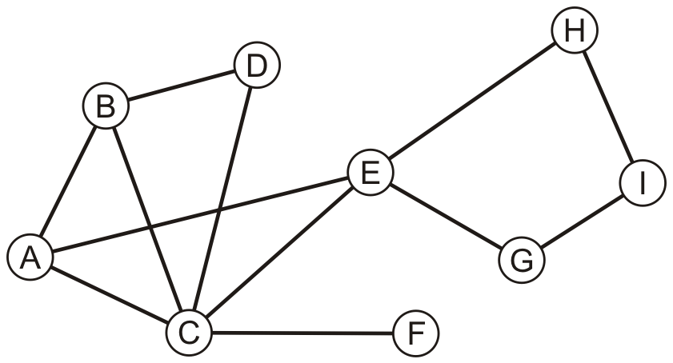
Breadth-First Example
Consider this graph
Performing a breadth-first traversal
  add the first vertex, say A, onto the queue
A

Slide 18
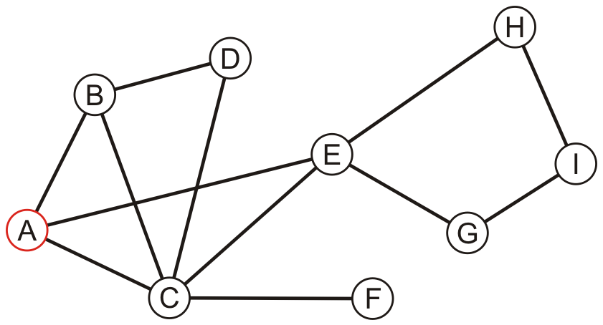
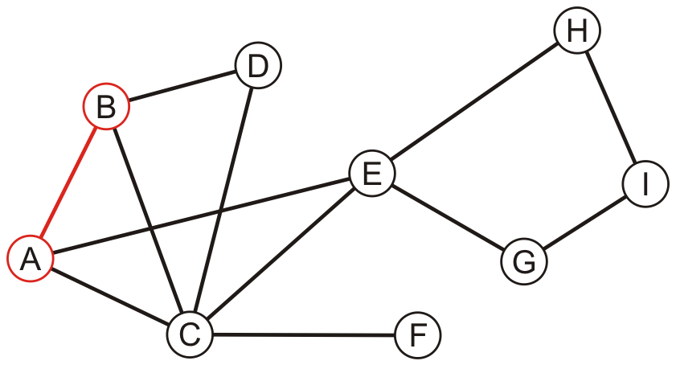
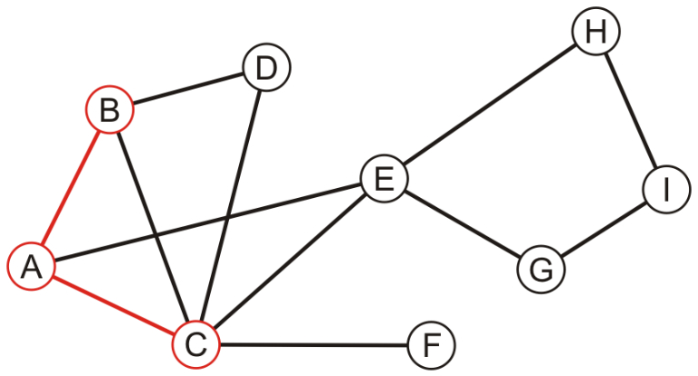
Breadth-First Example
Performing a breadth-first traversal
  remove A and add B, C and E
  A
B | C | E
  remove B and add D
  A, B
C | E | D
  remove C and add F
  A, B, C
E | D | F

Slide 19
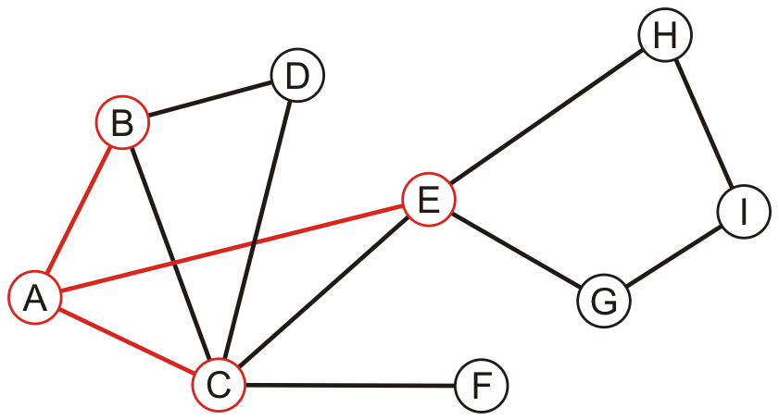
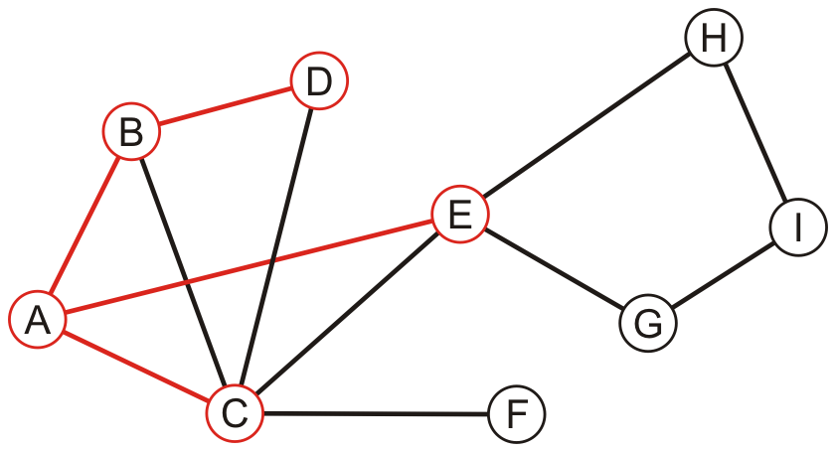
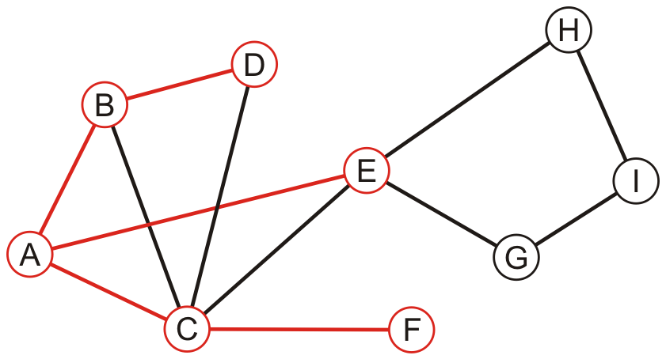
Breadth-First Example
  remove E and add G and H
  A, B, C, E
D | F | G | H
  remove D
  A, B, C, E, D
F | G | H
  remove F
  A, B, C, E, D, F
G | H

Slide 20
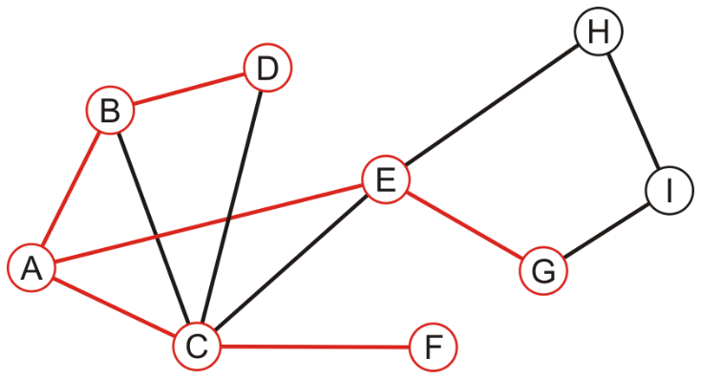
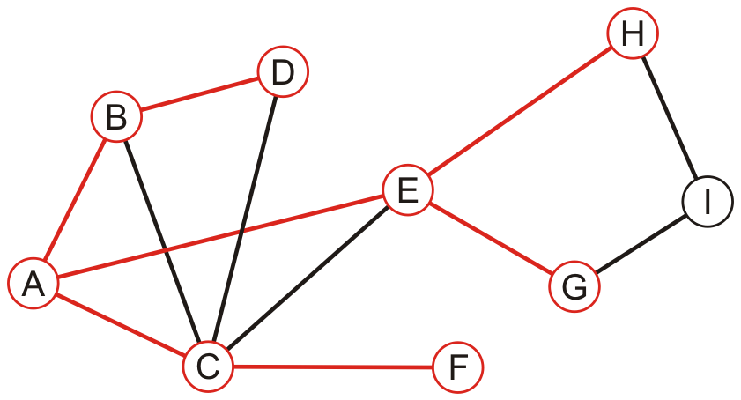
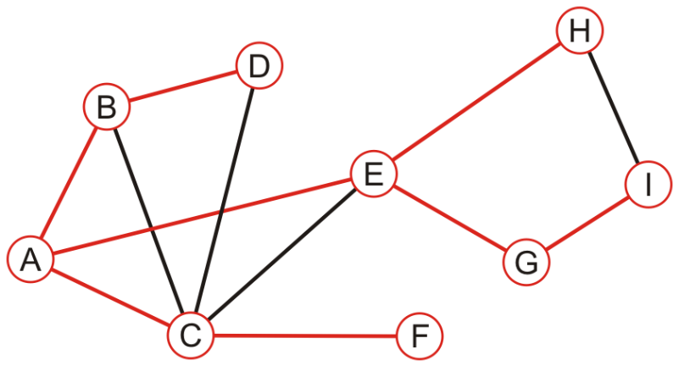
Breadth-First Example
  remove G and add I
  A, B, C, E, D, F, G
H | I
  remove H
  A, B, C, E, D, F, G, H
I
  remove I
  A, B, C, E, D, F, G, H, I
The queue is empty: we are finished

Slide 21
Breadth-First Example
Perform a depth-first traversal on this same graph

